Slide 1


Application of the Concept of Machine-Actionable Data Management Plan in ELIXIR
João Cardoso, Tomasz Miksa, José Borbinha, Rob Hooft and Robert Pergl

Slide 2
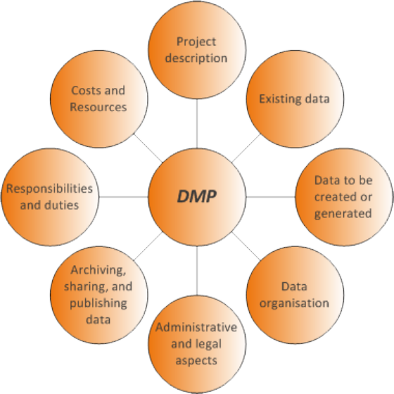



1. Data Management Plans
1.1. What is a Data Management Plan (DMP)
A DMP is a document used to support data management in research projects.
That implies detailing its :
  Identity
  Organization
  Documentation
  Data Quality
  Preservation
  Policies
  Dissemination,
  Etc…
Currently most DMPs are manually created by researchers using checklists and online tools, such as DMP Tool or DMP Online.
https://en.uit.no/ub/forskningsstotte/art?p_document_id=473665
https://dmptool.org/
https://dataone.org
https://dmponline.dcc.ac.uk/

Slide 3

1. Data Management Plans
1.2. DMP Drawbacks
In effect, currently a DMP is a mostly static document.
The information is often broad and unclear. Varying both on the degree of expertise and meticulousness of the DMP creator.
Ideally a DMP should be dynamic in nature, and a fundamental part of research.
A human-readable description is always needed, however DMPs should have machine-actionable added value
It is however often considered a bureaucratic hassle.
https://www.economist.com/sites/default/files/imagecache/1000-width/images/print-edition/20170826_MAD001_0.jpg
Notes:
In practice, researchers without a background in data curation have difficulty navigating the DMP, thus
propagating inappropriate data management practices.

Slide 4
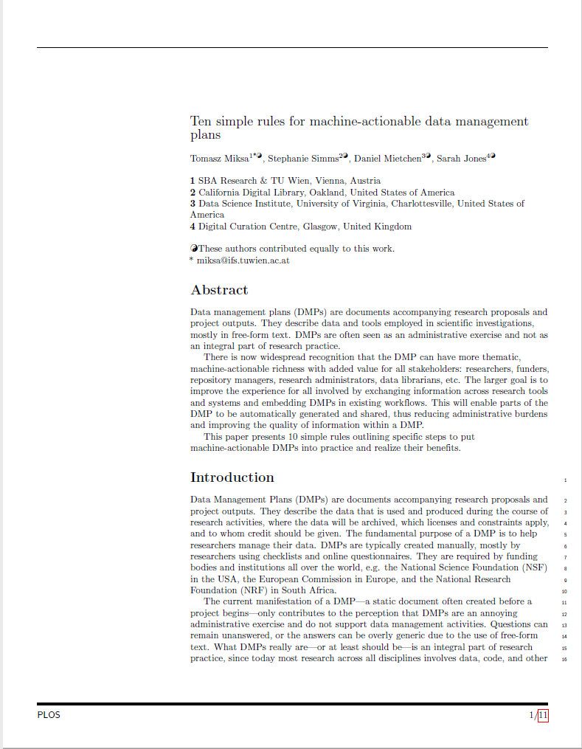
2. Actionable-Machine Data Management Plan
2.1. Why a Machine-Actionable DMP (maDMP)?
The Machine-Actionable Data Management Plan (maDMP) concept appeared to extend the concept of DMP.
The maDMP aims to have DMPs be:
  Machine and Human Readable
  Enable Automated Policy Enforcement
  Sharable
  Common Data Model
  Allow for the integration of systems and tools
  Etc...
https://riojournal.com/articles.php?id=13086
https://doi.org/10.5281/zenodo.1172673
Notes:
These two papers are fundamental in understanding the concept of maDMP.

Slide 5

2. Machine-Actionable Data Management Plan
2.2. Machine-Actionable Data Management Plan (maDMP) Requirements
We want to raise requirements for the application of the maDMP concept.
  Collect publicly available DMPs into a repository
  Analyse the DMPs to understand their present structure.
  Interview researchers and project managers
  To establish classifiers for automated processing (machine learning)
https://www.pinterest.com/pin/468444798720728178/
Notes:
We devised 4 ways to do so.

Slide 6
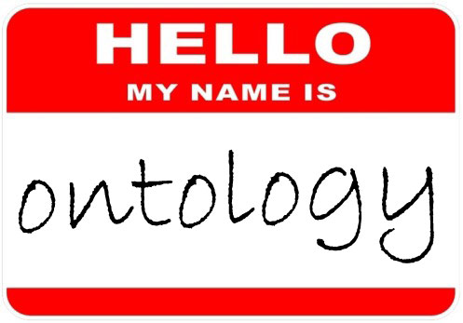
2. Machine-Actionable Data Management Plan
2.3. Our Approach
To represent the DMPs through an ontology based structure
We can then apply this approach to DMPs of different contexts.
DMP Extension of the DataID Ontology
http://wiki.dbpedia.org/use-cases/data-management-plan-extension-dataid
Ontologies are valuable tools for data management.
Interoperability between systems is enabled, whilst still being human readable.
Reasoning
Unique identification disambiguation of concepts
Notes:
Ontologies, through their formal semantics, facilitate knowledge transfer, detection
of logical inconsistencies and deriving implicit facts. For they provide unique
identification and disambiguation of concepts.

Slide 7
3. ELIXIR
3.1. What is ELIXIR?
ELIXIR is an intergovernmental organization that brings together life science resources from different organizations across Europe.
The goal of ELIXIR is to coordinate these resources so that they form a single infrastructure.
The scientific and technical activities in ELIXIR are run by five Platforms and four Use Cases.
https://drive.google.com/file/d/0B8in1NtGRloYcFNLSFpZWWthYzg/view?usp=sharing
Notes:
There are currently 21 members with over 160 research institutes.
These resources include databases, software tools, training materials, cloud storage and supercomputers.
This infrastructure makes it easier for scientists to find and share data, exchange expertise, and agree on best practices.
Platforms bring together experts to define the strategy and provide services in a particular area
Use Cases bring together scientists who work in a specific domain

Slide 8
3. ELIXIR
3.1. What is ELIXIR?
Platforms bring together experts to define the strategy and provide services in a particular area
  Data
  Interoperability
  Tools
  Compute
  Training
Use Cases bring together scientists who work in a specific domain
  Marine Metagenomics
  Rare Disease
  Human Data
  Plant Sciences
https://drive.google.com/file/d/0B8in1NtGRloYcFNLSFpZWWthYzg/view?usp=sharing
Notes:
Data Platform Aims to identify key data resources across Europe and support the linkages between data and literature.
Interoperability Platform Develops and encourages the adoption of standards to describe life science data.
Tools Platform Helps researchers find the best software tools to analyse their data.
Compute Platform Develops services to make it easier to store, share and analyse large datasets.
Training Platform Helps scientists and developers find the training they need, and also provides that training.
Marine Metagenomics Develops a sustainable metagenomics infrastructure to nurture research and innovation in the marine domain.
Rare Disease Supports the development of new therapies for rare diseases.
Human Data Develops long-term strategies for managing and accessing sensitive human data.
Plant Sciences Develops an infrastructure to facilitate genotype-phenotype analysis for crop and tree species.

Slide 9

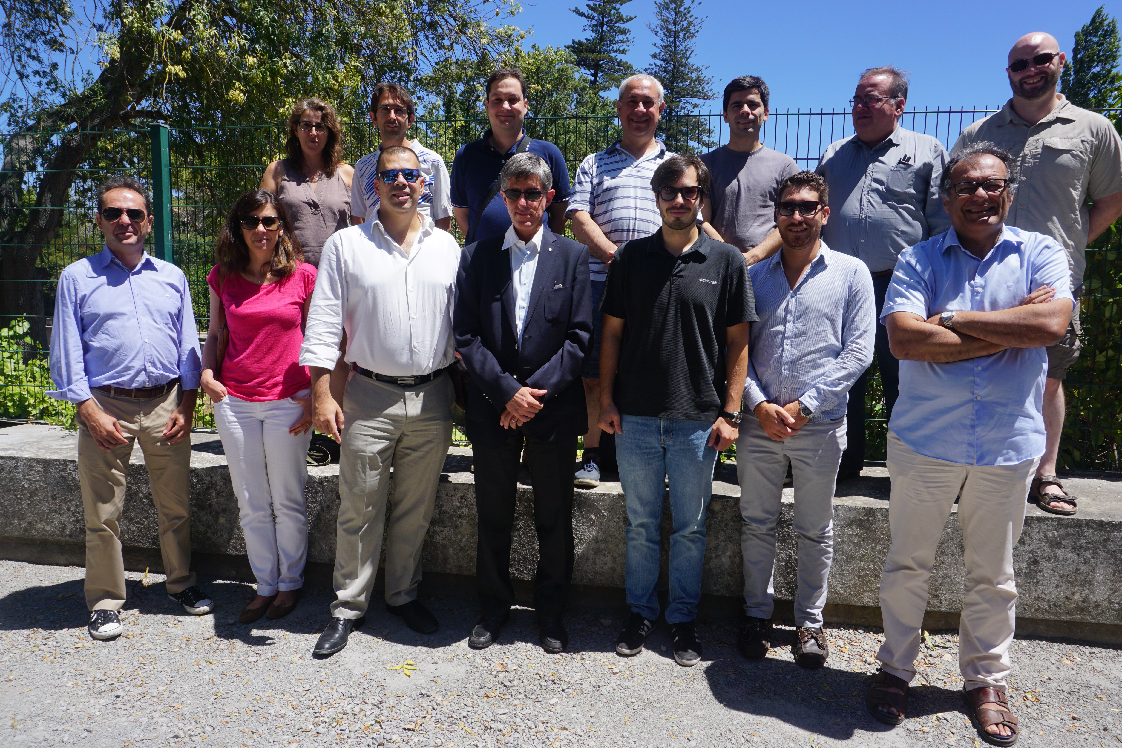
3. ELIXIR
3.2. What is ELIXIR Portugal?
ELIXIR Portugal is the Portuguese node of ELIXIR.
ELIXIR Portugal is organized as a consortium of four Portuguese research institutions which are part of the national biological information network BioData.pt
ELIXIR Portugal's main contribution to the ELIXIR project is on the Woody Plants domain. It aims to provide data, tools, standards and training in this domain.
https://biodata.pt/about_elixirpt
Notes:
Woody plants are a major natural resource in Europe, with a huge ecological and economical impact, supporting millions of jobs across diverse industries (e.g., wine, fruit, olive oil, coffee, paper, timber, cork) and strongly contributing to the European GDP. In Portugal, woody plants represent 10% of the exports, and are a central research domain in both academia and industry. Elixir Portugal aims to provide data, tools, standards, and training in this domain and thus contribute to build an ELIXIR framework that is of added-value to all woody plant based industries.

Slide 10



3. ELIXIR
3.3. Data Management Plans and ELIXIR
ELIXIR CZ and ELIXIR NL are jointly introducing the Data Stewardship Portal.
Educate researchers in Data Stewardship, provide aid from ELIXIR experts, and help in creating Data Management Plans
ELIXIR members are present in RDA work groups on both DMP standards and Machine-Actionable DMP.
https://github.com/datastewardshipportal
http://dmp.fairdata.solutions
https://www.rd-alliance.org/groups/dmp-common-standards-wg
https://www.rd-alliance.org/groups/active-data-management-plans.html
Notes:
1. The service is live at dmp.fairdata.solutions; I advertise it at the moment as a way to enrich a data management plan that people are writing, e.g. using a web tool like dmponline.
2. We are following along with RDA groups on machine actionable DMP. Especially the "common format" working group, where I will be giving a flash presentation next week. https://www.rd-alliance.org/groups/dmp-common-standards-wg

